Slide 1

Project Report on
Banking Management System in JAVA
Submitted by:
Name | Rajesh | Satya | SaiSree
Roll no | 51 | 40 | 72
Reg. no. | 12115363 | 12114535 | 12114133
Section | K21QT | K21QT | K21QT

Slide 2
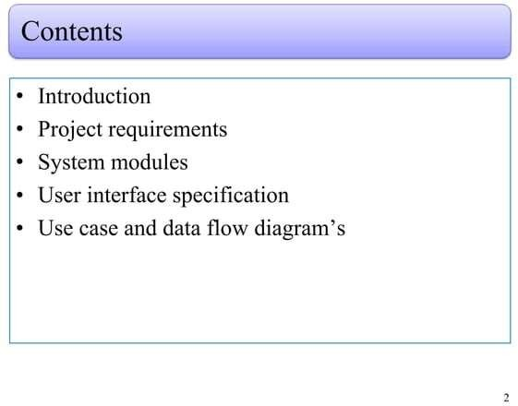
lOMoARcPSD|23690038

Slide 3
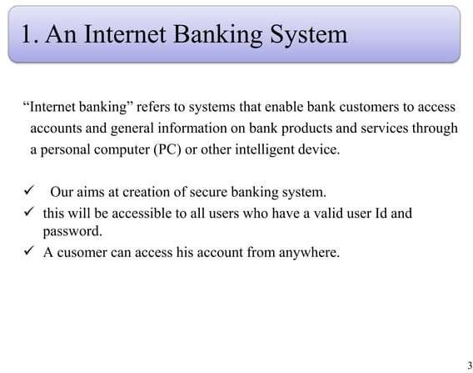
lOMoARcPSD|23690038

Slide 4
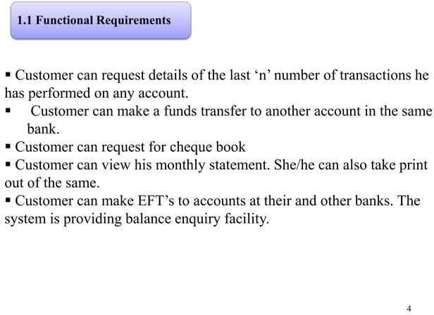
lOMoARcPSD|23690038

Slide 5
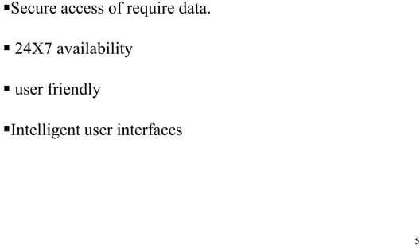
lOMoARcPSD|23690038

Slide 6
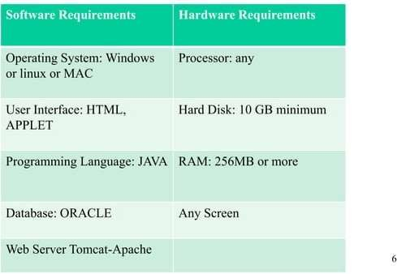

lOMoARcPSD|23690038

Slide 7
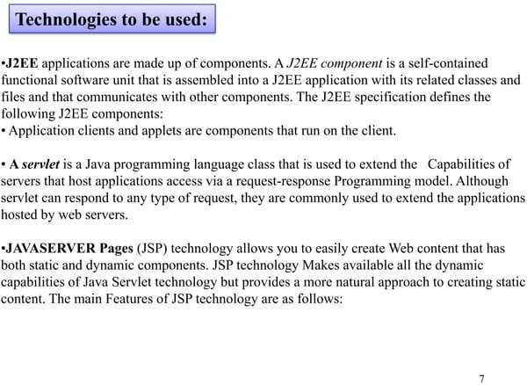
lOMoARcPSD|23690038

Slide 8
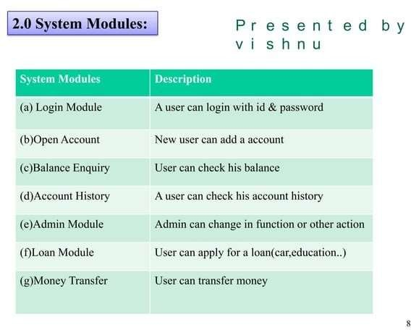











lOMoARcPSD|23690038

Slide 9
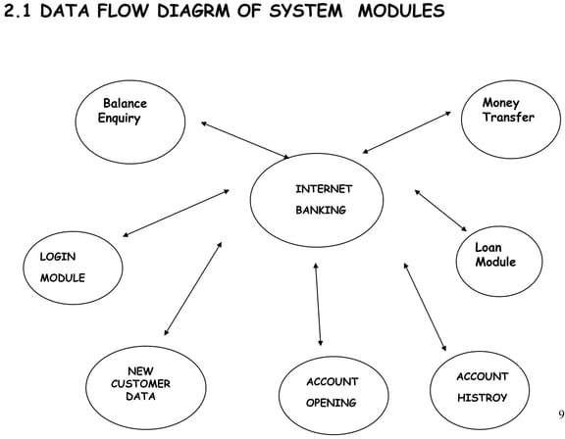

lOMoARcPSD|23690038

Slide 10
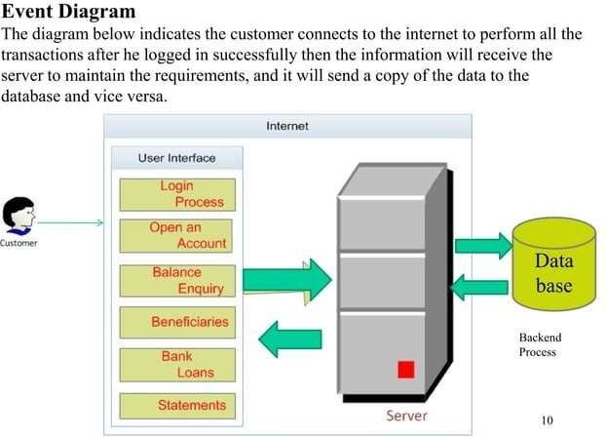
lOMoARcPSD|23690038

Slide 11
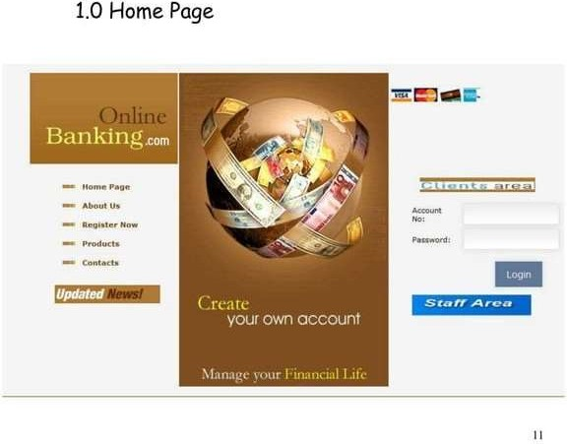
lOMoARcPSD|23690038

Slide 12
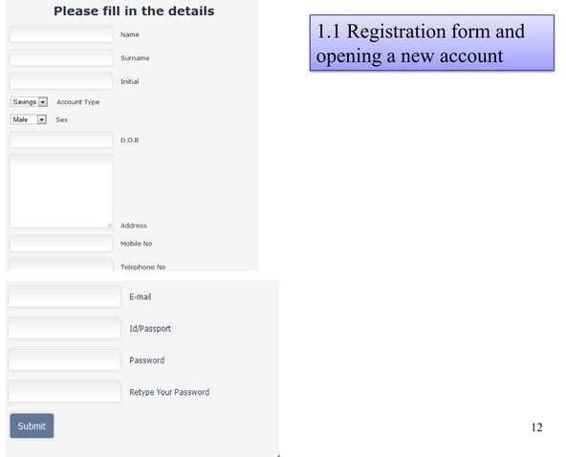
lOMoARcPSD|23690038

Slide 13
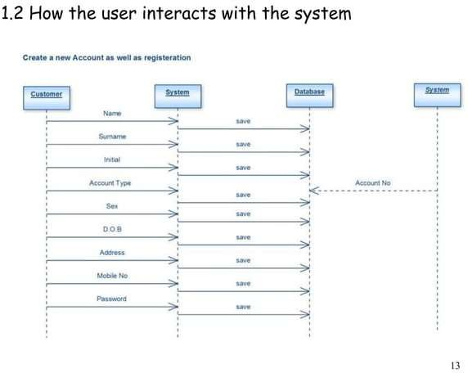
lOMoARcPSD|23690038

Slide 14
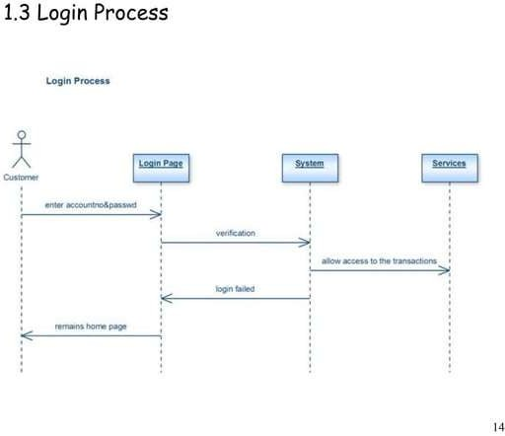
lOMoARcPSD|23690038

Slide 15
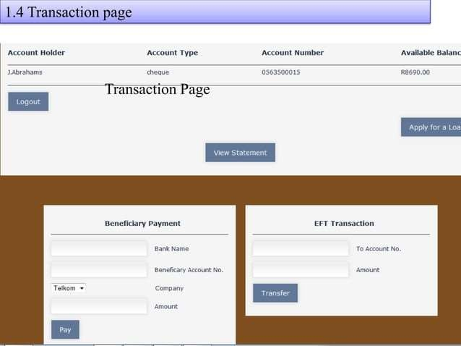
lOMoARcPSD|23690038
Downloaded by Serena Sinha (serena31may@gmail.com)

Slide 16
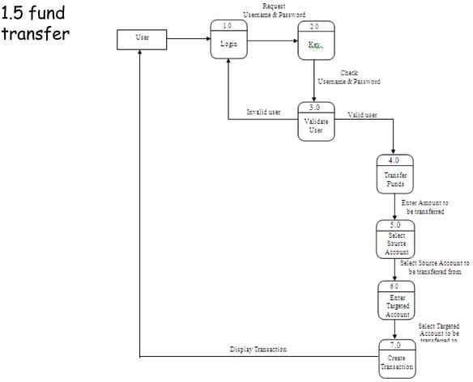
lOMoARcPSD|23690038

Slide 17
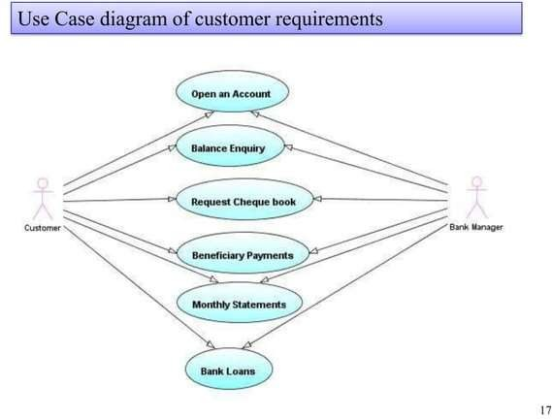
lOMoARcPSD|23690038

Slide 18
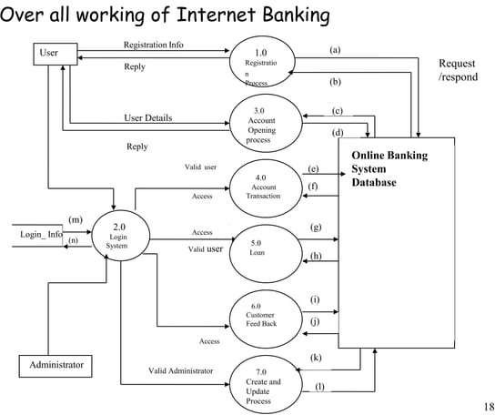
lOMoARcPSD|23690038

Slide 19
Banking Management System Code: in java
mport java.util.Scanner;
public class BankApplication {
public static void main(String[] args) { Scanner sc=new Scanner(System.in);
System.out.println("Enter your 'Name' and 'CustomerId' to access your Bank account:");
String name=sc.nextLine(); String customerId=sc.nextLine();
BankAccount obj1=new BankAccount(name,customerId);
obj1.menu();
}
}
class BankAccount{ double bal; double prevTrans;
String customerName;
String customerId;
BankAccount(String customerName,String customerId){ this.customerName=customerName; this.customerId=customerId;
}

Slide 20
void deposit(double amount){
if(amount!=0){ bal+=amount; prevTrans=amount;
}
}
void withdraw(double amt){ if(amt!=0 && bal>=amt){
bal-=amt; prevTrans=-amt;
}
else if(bal<amt){
System.out.println("Bank balance insufficient");
}
}
void getPreviousTrans(){ if(prevTrans>0){
System.out.println("Deposited: "+prevTrans);
}
else if(prevTrans<0){
System.out.println("Withdrawn: "+Math.abs(prevTrans));
}
else{
System.out.println("No transaction occured");
}
}

Slide 21
void menu(){
char option;
Scanner sc=new Scanner(System.in); System.out.println("Welcome "+customerName); System.out.println("Your ID:"+customerId); System.out.println("\n");
System.out.println("a) Check Balance"); System.out.println("b) Deposit Amount"); System.out.println("c) Withdraw Amount"); System.out.println("d) Previous Transaction"); System.out.println("e) Exit");
do{
System.out.println("****************"); System.out.println("Choose an option"); option=sc.next().charAt(0); System.out.println("\n");
switch (option){ case 'a':
System.out.println("......................"); System.out.println("Balance ="+bal); System.out.println("......................"); System.out.println("\n");
break;
case 'b':
System.out.println("......................"); System.out.println("Enter a amount to deposit :"); System.out.println("......................");
double amt=sc.nextDouble(); deposit(amt); System.out.println("\n"); break;

Slide 22
case 'c':
System.out.println("......................"); System.out.println("Enter a amount to Withdraw :"); System.out.println("......................");
double amtW=sc.nextDouble(); withdraw(amtW); System.out.println("\n"); break;
case 'd': System.out.println("......................");
System.out.println("Previous Transaction:"); getPreviousTrans(); System.out.println("......................"); System.out.println("\n");
break;
case 'e': System.out.println("......................"); break;
default:
System.out.println("Choose a correct option to proceed");
break;
}
}while(option!='e');
System.out.println("Thank you for using our banking services");
}
}

Slide 23
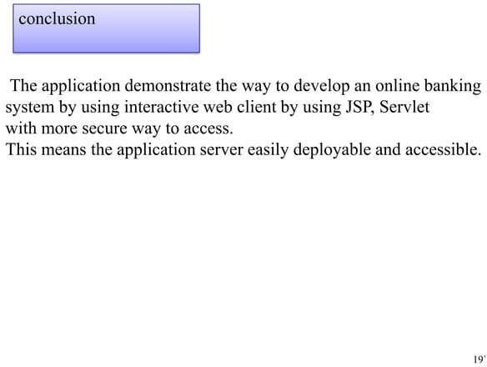
lOMoARcPSD|23690038

